Slide 1
HALUM E-commerce Online Shopping During Covid-19 Pandemic Situation
Submitted By
Kazi Shayem Mahamood
18-37296-1
Department of CSE, American international university of Bangladesh (AIUB)

Slide 2

Introduction
WHAT IS E-COMMERCE?

Slide 3

Why Use E-Commerce?

Slide 4
There are 4 major types of E-commerce:
Business to business (B2B)
Business to consumer (B2C)
Consumer to Consumer (C2C)
Consumer to Business (C2B)

Slide 5
METHODOLOGY
Primary sources
Secondary sources

Slide 6
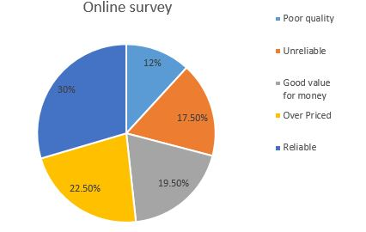
Result
My survey report:
Which of the following word would you use to describe HALUM.com product?
60 responses

Slide 7
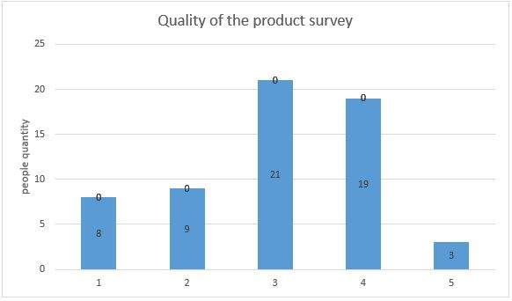
How would you rate the quality of the product?

Slide 8
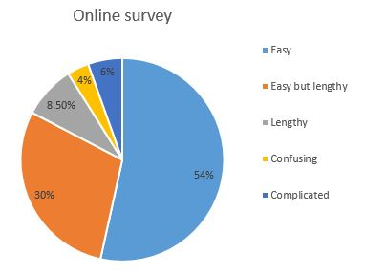
How will you describe the ordering method of HALUM.com?

Slide 9
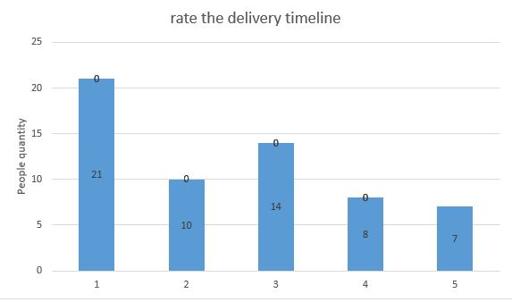
How will you rate the delivery timeline?

Slide 10
Conclusion

Slide 11
Thank you
Any Question?

